Slide 1
Predicting Problematic Internet Use
Notes:
The goal of our project is to

Slide 2

Do physical handicaps affect people's perceptions of employment qualifications?

Slide 3

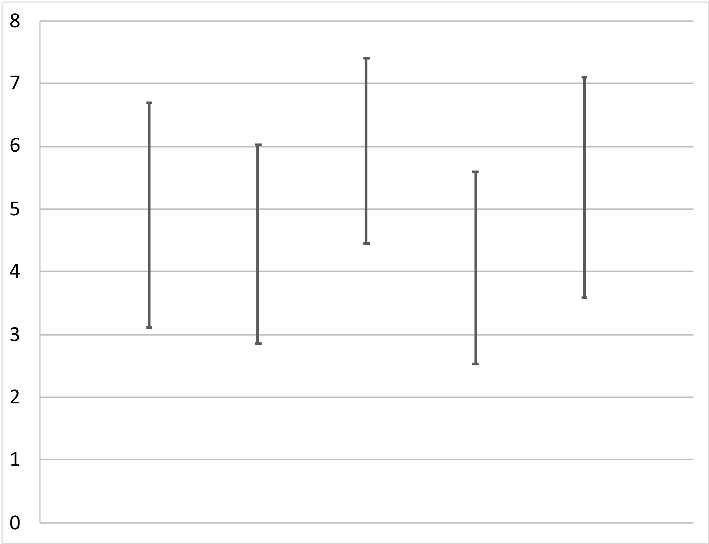









Do physical handicaps affect people's perceptions of employment qualifications?
Null Hypothesis:
$$μ_{None}$$
$$=$$
$$μ_{Amputee}$$
$$=$$
$$μ_{Crutches}$$
$$=$$
$$μ_{Hearing}$$
$$=$$
$$μ_{Wheelchair}$$
Two standard errors
Not strong evidence against null hypothesis
None | Amputee | Crutches | Hearing | Wheelchair
Notes:
Here is a graph of the mean scores. There appears to be [click] quite a bit of variation between these sample means. And the [click] dot for having crutches looks like it’s higher than the others [click] but let’s also think about the amount of variation within each group. [click] The length of these bars [click] corresponds to two standard errors above or below the mean – roughly the width of a 95% confidence interval. That is, these bars represent how much variation we’d expect to see from sample to sample within each population. And it looks like there is quite a bit of variation. For example, these suggest that the population mean for the hearing group [click] might be as large as this, which is [click] larger than the bottom of the interval for the crutches group [click]. So it doesn’t look like these [click] data would be strong evidence against our null hypothesis. [wait 2 seconds] Now, what if our data had looked a little different? [click]

Slide 4
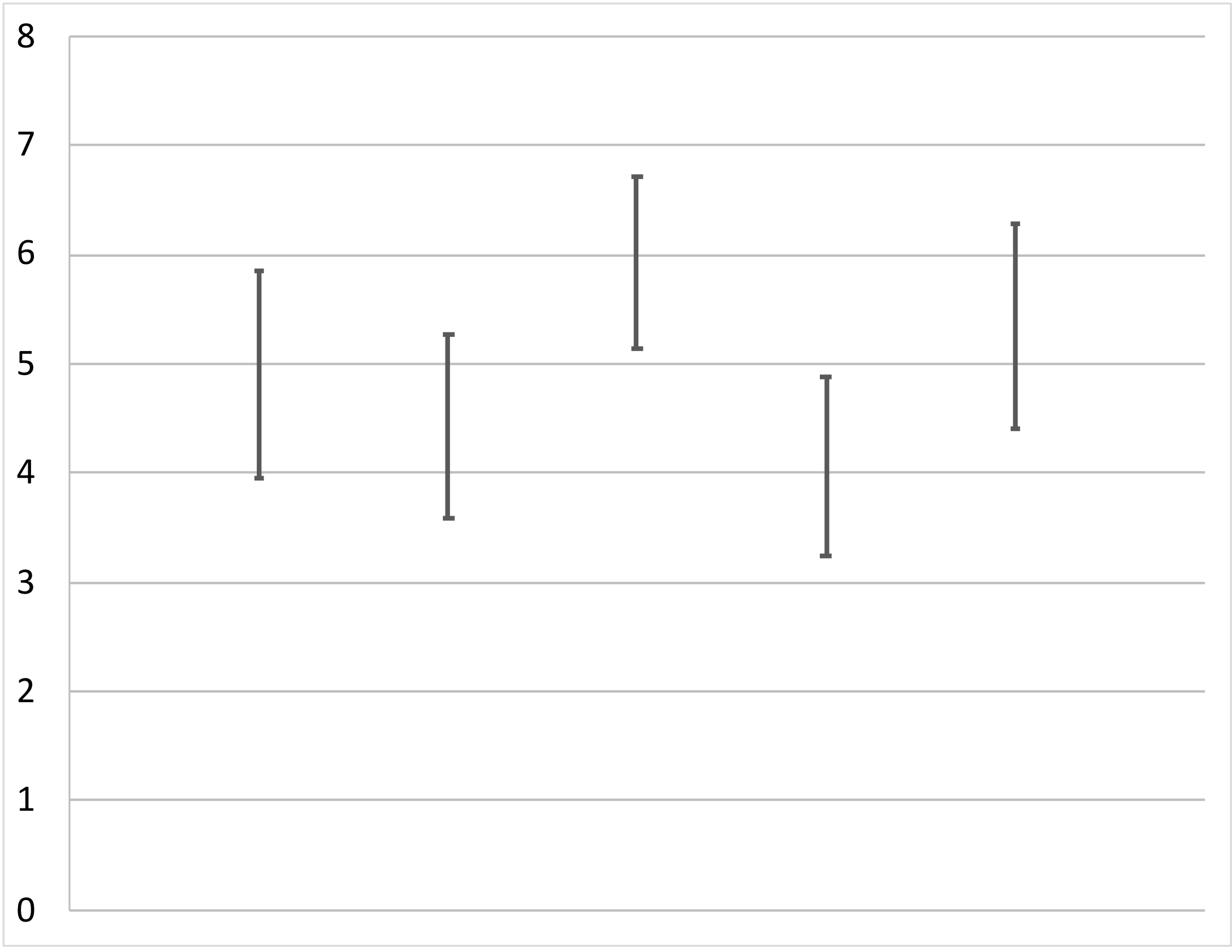
Do physical handicaps affect people's perceptions of employment qualifications?
Null Hypothesis:
$$μ_{None}$$
$$=$$
$$μ_{Amputee}$$
$$=$$
$$μ_{Crutches}$$
$$=$$
$$μ_{Hearing}$$
$$=$$
$$μ_{Wheelchair}$$
Two standard errors
Strong evidence against null hypothesis?
None | Amputee | Crutches | Hearing | Wheelchair
Notes:
What if the error bars [click] had only been this long? Now it looks like [click] the population means might not have the same value in some cases, although [click] there might be some overlap in other cases. So here it looks like the population means might not all be the same as each other – that is, it seems like [click] we might have strong evidence against our null hypothesis. [wait 2 seconds] So let’s take a step back and think about how we were making these inferences. [click]

Slide 5
Do physical handicaps affect people's perceptions of employment qualifications?
Null Hypothesis:
$$μ_{None}$$
$$=$$
$$μ_{Amputee}$$
$$=$$
$$μ_{Crutches}$$
$$=$$
$$μ_{Hearing}$$
$$=$$
$$μ_{Wheelchair}$$
Variation between sample means
Variation between sample means
Variation within each group
When this ratio is large, it is evidence that the population means are not all equal
Variation between sample means
Variation within each group
None | Amputee | Crutches | Hearing | Wheelchair
Notes:
There are two types of variation we’re seeing here. One is [click] the variation between the sample means, which we can see [click] as the amount of variation in the vertical position of the blue dots on the graph. The other type of variation is [click] the variation within each group, which we can see as the [click] amount by which the parameter might vary from the observed sample mean. And what we’ve done is to compare these two types of variation. That is, we looked at [click] the ratio of the variation between the means to the variation within each group. And [click, reading] when this ratio is large, it is evidence that the population means are not all equal. So in the example here, when we [click] looked at the amount of variation between the means and [click] the variation within each group [click] and compared these amounts, the variation between was larger, and we had evidence that the population means are not all equal. [click]

Slide 6
Do physical handicaps affect people's perceptions of employment qualifications?
Null Hypothesis:
$$μ_{None}$$
$$=$$
$$μ_{Amputee}$$
$$=$$
$$μ_{Crutches}$$
$$=$$
$$μ_{Hearing}$$
$$=$$
$$μ_{Wheelchair}$$
When this ratio is large, it is evidence that the population means are not all equal
Variation between sample means
Variation within each group
None | Amputee | Crutches | Hearing | Wheelchair
Notes:
In contrast, in our original example, [click] when we looked at the [click] amount of variation between the sample means and [click] the amount of variation within the groups, then the ratio was relatively small, so it was not evidence against the null hypothesis. [wait 1 second] So this is the intuition behind making an inference for comparing multiple population means. What we need is a new type of statistic that lets us formalize this comparison. And we’ll look at how to do that in the next video [wait 2 seconds] [click]

Slide 7
Copyright © 2020 the Statistics Video Project

